Slide 1
DIGITAL TWIN CHALLENGE 2026
DiaTwin
A Multimodal Metabolic Digital Twin for Forecasting Glycemic Trajectories

Slide 2


THE INDIAN T2D CRISIS
Reactive monitoring fails patients.
101M
Diagnosed T2D cases in India.
High-carbohydrate dietary staples trigger extreme postprandial excursions. Current tools only report the past.

Slide 3

THE SOLUTION
Continuous
In-Silico Replica
Anticipates critical events.
Models complex glycemic trajectories.
Enables preemptive clinical action.

Slide 4

SYSTEM ARCHITECTURE
Dual Data Stream Fusion
Static EHR Data
Dynamic Telemetry
SYNTHEA / MIMIC-IV
WEARABLE SENSORS
Baseline metabolic phenotypes.
Continuous interstitial glucose.
Laboratory biomarker profiles.
Autonomic stress biomarkers.
Active pharmacological regimens.
Physical exertion intensity.

Slide 5
MACHINE LEARNING
Algorithmic Processing
01
02
03
Data Preprocessing
Contextual Gating
Predictive Engine
Tabular and temporal normalization.
Static features modulate dynamics.
Multi-horizon trajectory forecast.

Slide 6

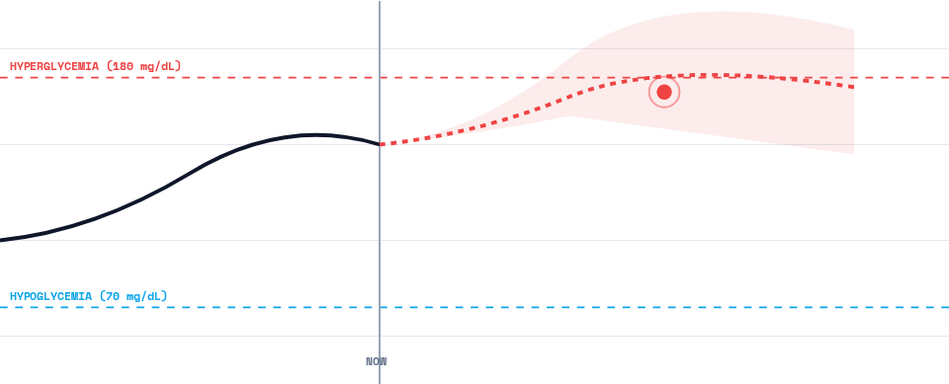
TEMPORAL FUSION TRANSFORMER
120-Minute Predictive Horizon

Slide 7
COUNTERFACTUAL ENGINE
The "What-If" Simulator
Test therapeutic interventions safely in-silico.
Nutritional Disturbance
Activity Intervention
ACTION: 45G CARBOHYDRATE MEAL
ACTION: 15-MINUTE MODERATE WALK
Model projects severe postprandial spike crossing threshold.
Model projects immediate spike attenuation below hazard lines.

Slide 8



Clinician Command Center
Dynamic Canvas
Phenotype Replica
Automated Triage
Real-time trajectories with predictive confidence cones.
Organ risk metrics computed from baseline clinical data.
Priority queue highlighting nocturnal hypoglycemia risks.

Slide 9
EVALUATION FRAMEWORK
Clinical Performance Targets
<10%
>98%
45m
Target MARD
Zones A+B
Lead Time
Mean Absolute Relative Difference.
Clarke Error Grid accuracy.
Minimum warning before event.

Slide 10

Sandbox Compliance
Zero Persistence Architecture
Wearable simulations run exclusively in volatile memory.
Fully Synthetic Generation
Strict alignment with DPDP and HIPAA guidelines.
Deterministic Hashing
Patient identifiers completely replaced with pseudorandom hashes.

Slide 11
16-Day Execution Sprint
D1
D5
D9
D14
Data Pipeline
Model Fusion
Sandbox UI
Submission
Synthetic generation.
Predictive training.
Dashboard build.
Docs and demo.

Slide 12
Ready for the Summit.
DIGITAL TWIN CHALLENGE 2026

